Slide 1
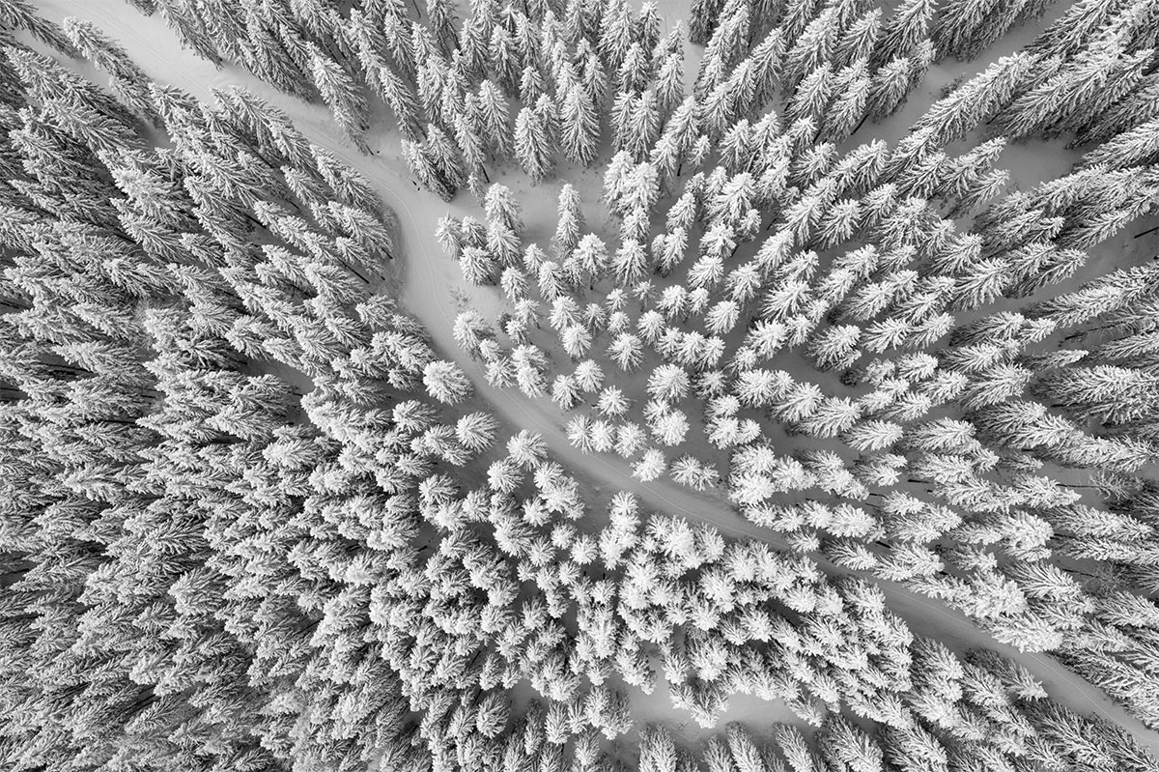
River monitoring and environmental impact system
Notes:
Cover page
Change background image by right-clicking → Edit background
Picture fill → From file
First move the gradient mask by activating it (clicking it) and moving it from right to left (from the middle handle point on the right) This way it is easy to put the gradient back by dragging the same handle to right.

Slide 2
Main purpose
Automation of measurements for more accurate estimation of risks and potential losses associated with flooding.
Assistance in finding solutions to prevent flooding or to reduce post flood damage.
Notes:
Text slide

Slide 3
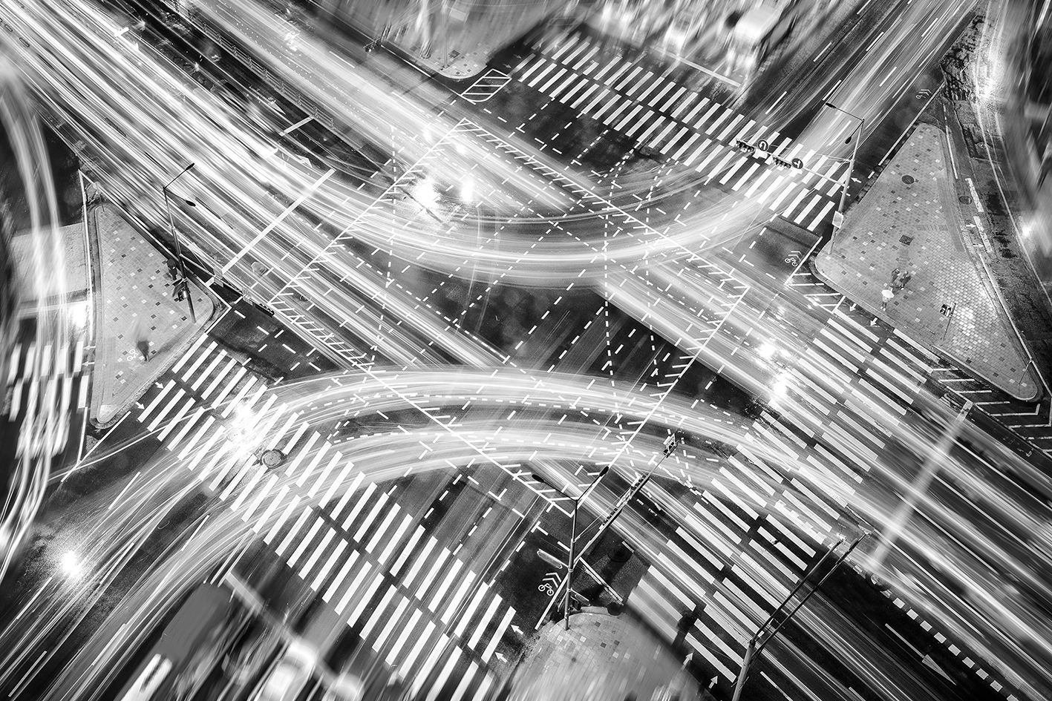

DATA
How we use satellite?
To acquire:
Digital Elevation Model
Land use
Weather data
Measurements of the water level
Notes:
Cover page
Change background image by right-clicking → Edit background
Picture fill → From file

Slide 4
Example methods in GIS software
Parametrization of the terrain:
  relative and absolute height
  slope and aspect
  transverse and longitudinal profile
  generating a land-use model
Notes:
New dia -> Text + graphics 2 columns

Slide 5
Example methods in GIS software
Parametrization of the water relations
Preparation of data for symulation
Visualization of data
Notes:
New dia -> Text + graphics 2 columns

Slide 6
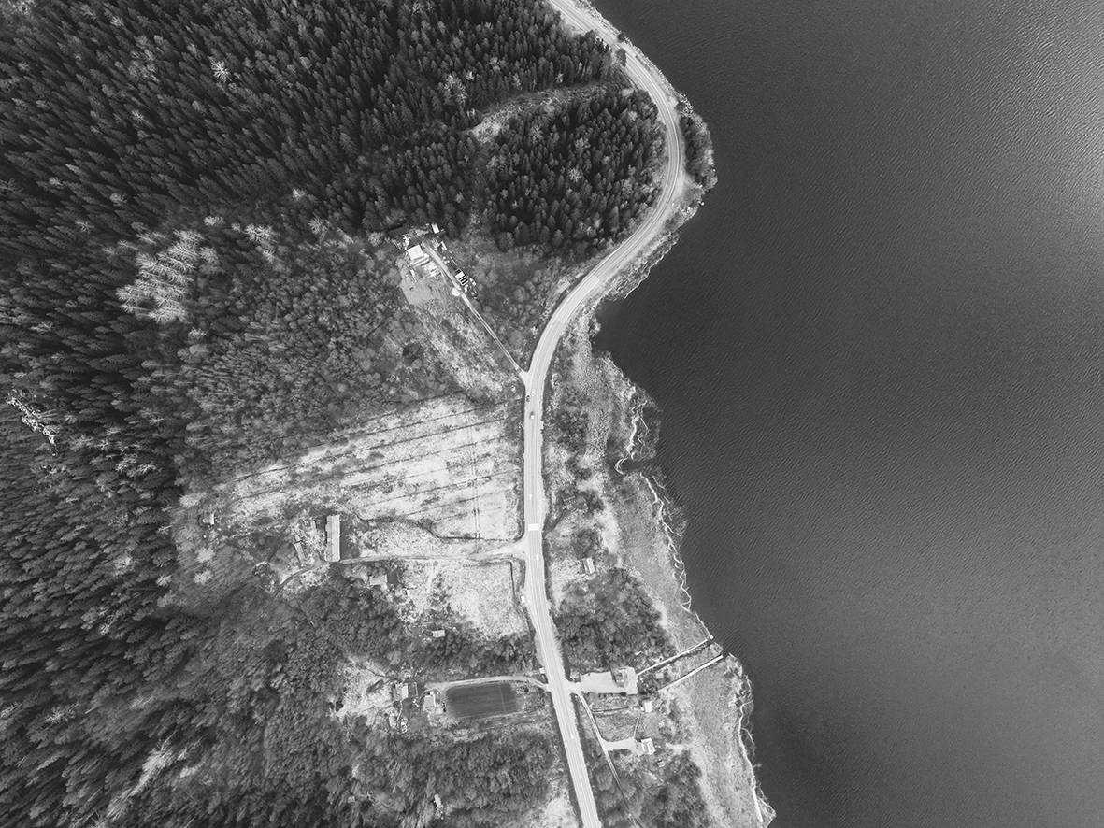
POSSIBILITIES
(are dependent on the recipient)
Early detection of floods with high probability
Selection of river sections to be regulated
Estimation of possible losses
Selection of the areas whose flooding will cause the least damage
Detection of water pollution
Notes:
Cover page
Change background image by right-clicking → Edit background
Picture fill → From file

Slide 7
Advantages
Symulations with high probability
Algorithmization of solutions
Product modularity or creating from scratch products for individual recipient
Wide range of applications
Up-to-date data
Notes:
Change background image by right-clicking → Edit background
Picture fill → From file

Slide 8
Our future clients
State institutions
Developers
Producers and companies
Insurance companies
Individual recipients
Notes:
Change background image by right-clicking → Edit background
Picture fill → From file

Slide 9
Why we believe in our idea?
Current systems are far from perfect
We can help reduce the losses
Different solutions are automated

Slide 10
In Poland there are 314 poviats and 66 cities with poviat rights.
Interest - 30% (approx. 120 poviats)
  Maintenance costs:
  Sales and marketing - 1 person
  System development and server maintenance - 4 people
  Office
  Monthly costs: PLN 40,000 + one-off cost (equipment) PLN 150,000
Revenue: annual licence: PLN 6,000
Annual profit (not including one-off costs): PLN 240,000
Notes:
Cover page
Change background image by right-clicking → Edit background
Picture fill → From file

Slide 11
Something about us
Tomasz Włodarczyk
Krystian Typek
We are studying Geoinformatics at UMCS and we are working on a scientific project dealing with the study of vegetation in the Lublin Province.
Email address:
tomasz.wwlodarczyk@interia.eu krystian.typek@gmail.com
Notes:
Change background image by right-clicking → Edit background
Picture fill → From file

Slide 12

Thank you!
Notes:
Space for additional information, for example contact information.
The circle illustrates the various application areas of Copernicus data.
Change background image or colour by right-clicking → Edit background
Picture fill → From file

