Slide 1
Friendly cities
Healthy outdoor sport activities
Notes:
Cover page
Change background image by right-clicking → Edit background Picture fill → From file

Slide 2
Application based on satellite data, air pollution detectors and NDVI which support outdoor sport and recreational exercise activities.
Notes:
Cover page
Change background image by right-clicking → Edit background Picture fill → From file

Slide 3
This is us
Four students from AGH University of Science and Technology: Faculty of Geology, Geophysics and Environmental Protection:
Joanna Strug
Krzysztof Strzałkowski
Patryk Pociecha
Jakub Hejduk
One from Cracow University of Technology: Faculty of Physics, Mathematics and Computer Science :
Anna Stelmach
Notes:
Text slide

Slide 4
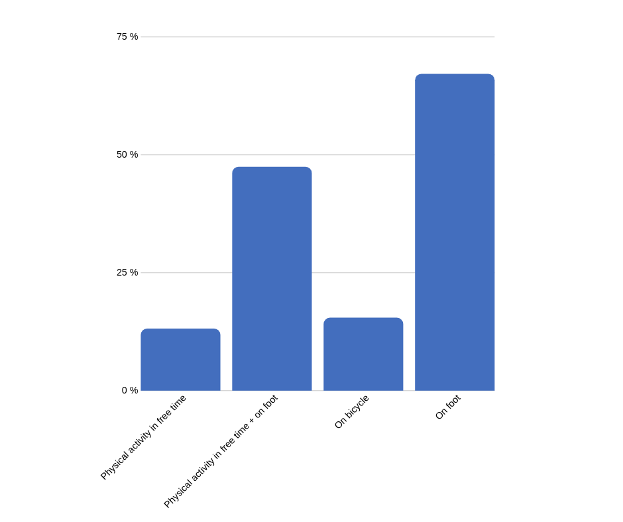
Receivers group: People who play sport more than once a week
Sport activity in Poland
Notes:
Space for additional information, for example contact information.
The circle illustrates the various application areas of Copernicus data.
Change background image or colour by right-clicking → Edit background Picture fill → From file

Slide 5
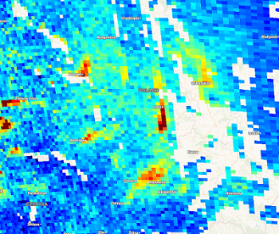
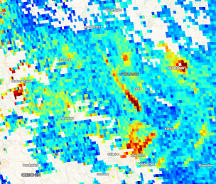
NO2 concentraction
25.04.2019
26.04.2019
Notes:
Text slide

Slide 6
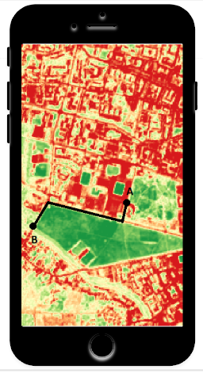
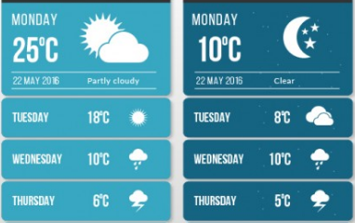
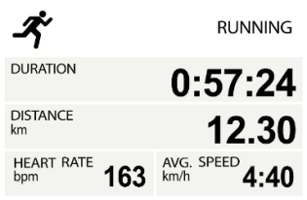
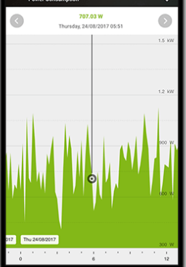
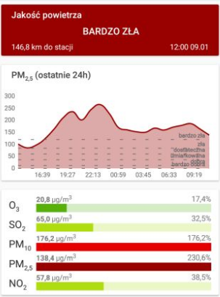
Notes:
Text slide

Slide 7
FOR FREE
Weather
Maps
Air pollution
PREMIUM
Less polluted routes
Green areas
Pollination of plants
Weather warnings
Notes:
Space for additional information, for example contact information.
The circle illustrates the various application areas of Copernicus data.
Change background image or colour by right-clicking → Edit background Picture fill → From file

Slide 8
ALL IN ONE
We compete with applications measuring air pollution, supporting running and using satellite data.
Innovative combination of all this
Notes:
Text slide

Slide 9
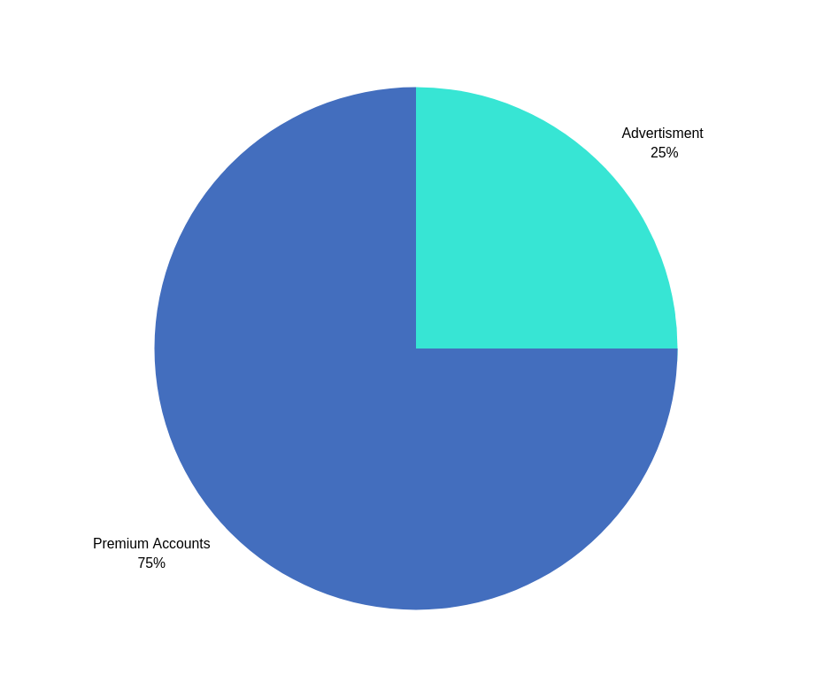
First year:
10 000 downloads
3 000 premium sold
It give us :
15 000 zl from premium
5 000 zl from advertisments
Second year:
100 000 downloads
30 000 premium sold
It give us :
150 000 zl from premium
50 000 zl from advertisements
mixed business model
Notes:
Space for additional information, for example contact information.
The circle illustrates the various application areas of Copernicus data.
Change background image or colour by right-clicking → Edit background Picture fill → From file

Slide 10
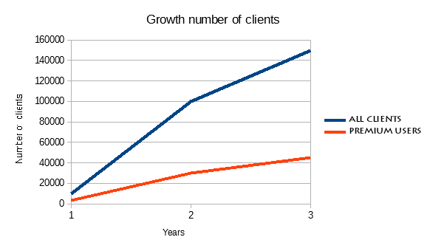
Notes:
Text slide

Slide 11
Thank you for your attention!
Contact:
annastelmach9696@gmail.com
asiastrug1997@vp.pl
patryk.pocie@gmail.com
ks270797@gmail.com
kubeck2@o2.pl
Notes:
Space for additional information, for example contact information.
The circle illustrates the various application areas of Copernicus data.
Change background image or colour by right-clicking → Edit background Picture fill → From file

