Slide 1
Making cities better
#Lisy

Slide 2
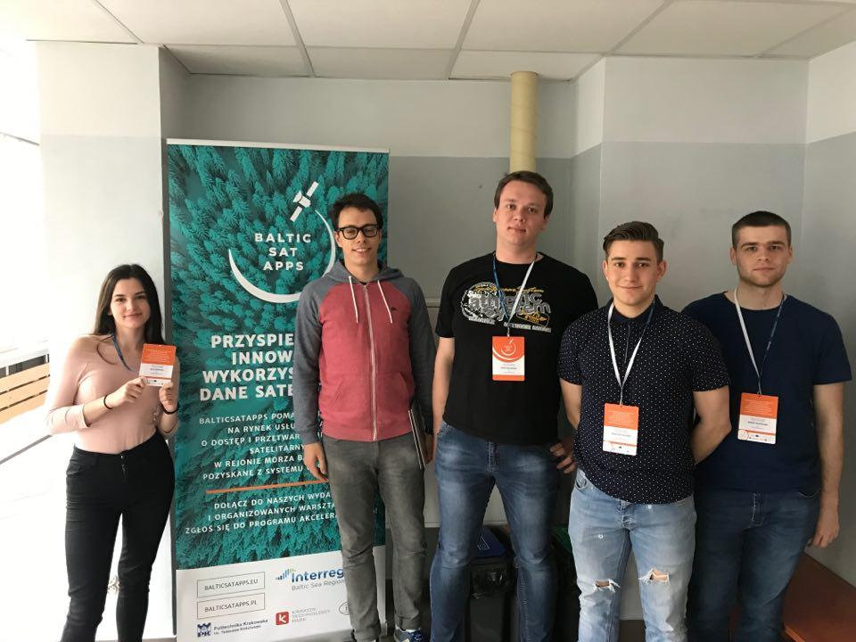
Who we are?
This is Julka, Kamil, Krystian, Sebastian and Paweł
Notes:
Text slide

Slide 3
Solving a real problem
We’ve picked up a difficult problem involving planning structures of modern cities. Our solution will help create cities that are friendly to people living in them. Keeping a perfect balance between modern architecture, parks and your time.
Notes:
Text slide

Slide 4
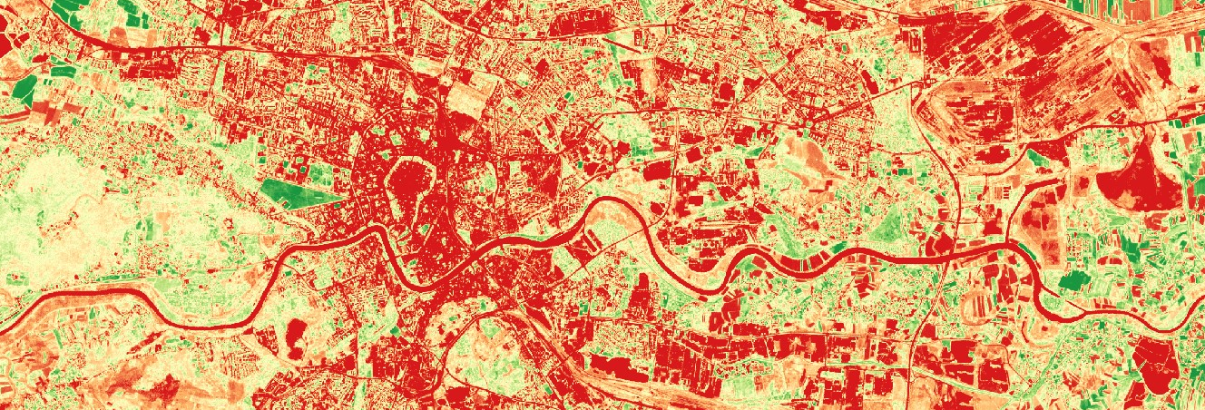
Product
By using combined data from multiple sources such as data from Sentinel 2, Geoportal, BDOT database and Urban Atlas we can both monitor the city and select the best place for next investition.
Notes:
Text slide

Slide 5
Advantages
Our product works in the background, automatically providing a report of problems found in the city. Allowing them to constantly improve and develop.
On the other hand developers can use our tool to find the best place for their next investition across entire country.
Notes:
Text slide

Slide 6
Market and Business Model
By providing multiple tiers our product would be affordable to both big and small cities. Very small cities can enjoy the basic set of tools for free.
Developers can pay yearly for access to our cloud. Personal use would be limited to 1 house per 5 years.
Notes:
Text slide

Slide 7
Thank you!
Notes:
Space for additional information, for example contact information.
The circle illustrates the various application areas of Copernicus data.
Change background image or colour by right-clicking → Edit background Picture fill → From file

Slide 8
Contact
Kamil Owczarz
owczarzk1@gmail.com
791 104 496
Notes:
Cover page
Change background image by right-clicking → Edit background Picture fill → From file

