Slide 1
Coastal areas & marine monitor
Authors:
Miłosz Szlachetka Monika Nowak
Michał Gucwa Agata Rybak
Piotr Smajek Michał Czyżowski
Bartłomiej Rolek
Notes:
Cover page
Change background image by right-clicking → Edit background Picture fill → From file First move the gradient mask by activating it (clicking it) and moving it from right to left (from the middle handle point on the right) This way it is easy to put the gradient back by dragging the same handle to right.

Slide 2
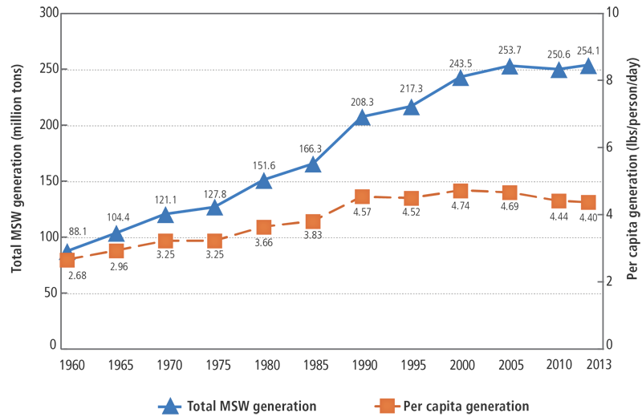
Waste production (1960-2013)
Notes:
Cover page
Change background image by right-clicking → Edit background Picture fill → From file

Slide 3
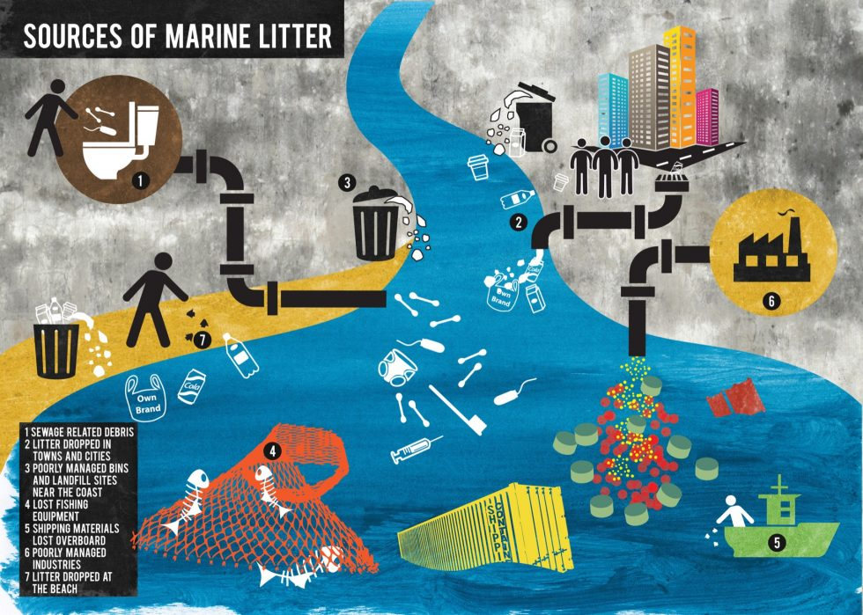
How much of it goes to the water?
Notes:
Cover page
Change background image by right-clicking → Edit background Picture fill → From file

Slide 4
8 to 10 million tons annually of plastic waste goes to sea and oceans
Notes:
Space for additional information, for example contact information.
The circle illustrates the various application areas of Copernicus data.
Change background image or colour by right-clicking → Edit background Picture fill → From file

Slide 5
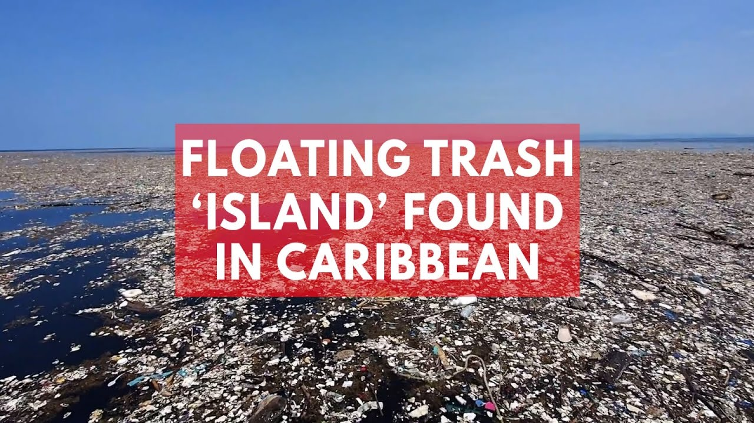
Notes:
Text slide

Slide 6
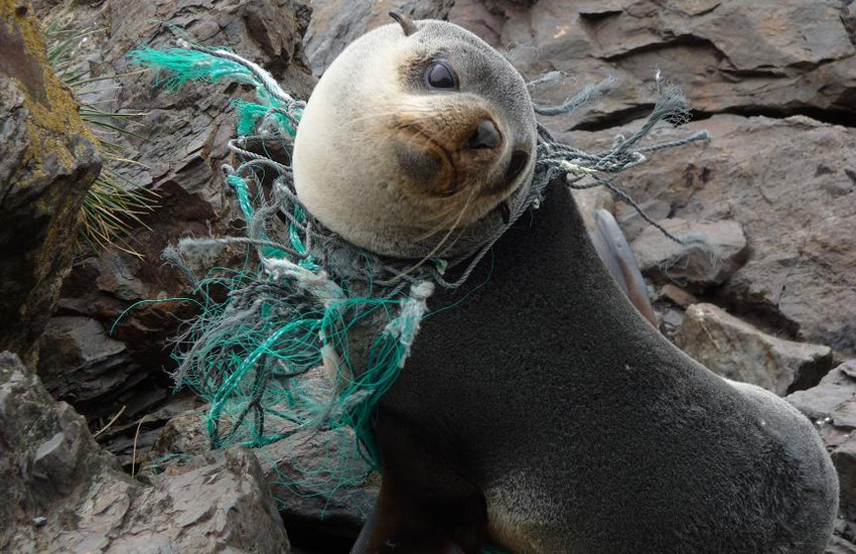

Slide 7
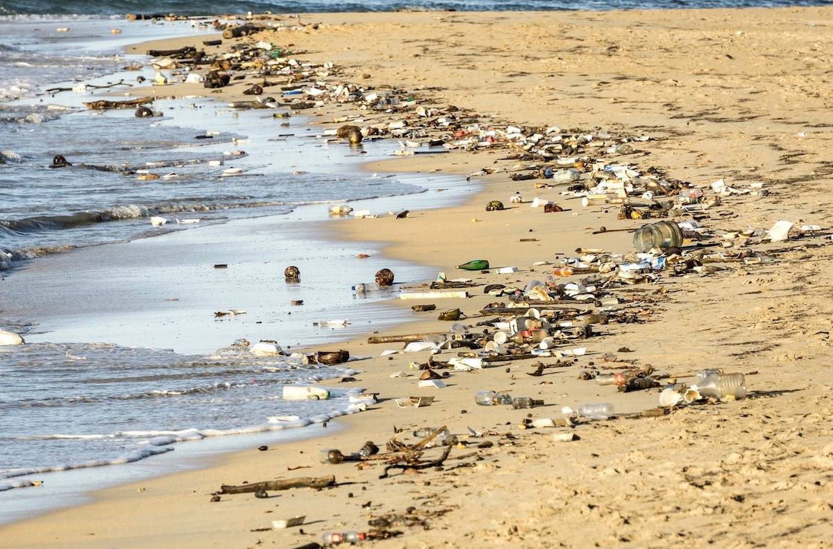
Notes:
Text slide

Slide 8
Organisations & events
Notes:
Cover page
Change background image by right-clicking → Edit background Picture fill → From file

Slide 9
Land patrol
Sea patrol
Airplane patrol
Drones
River monitoring
Current monitoring solutions
Notes:
Cover page
Change background image by right-clicking → Edit background Picture fill → From file

Slide 10
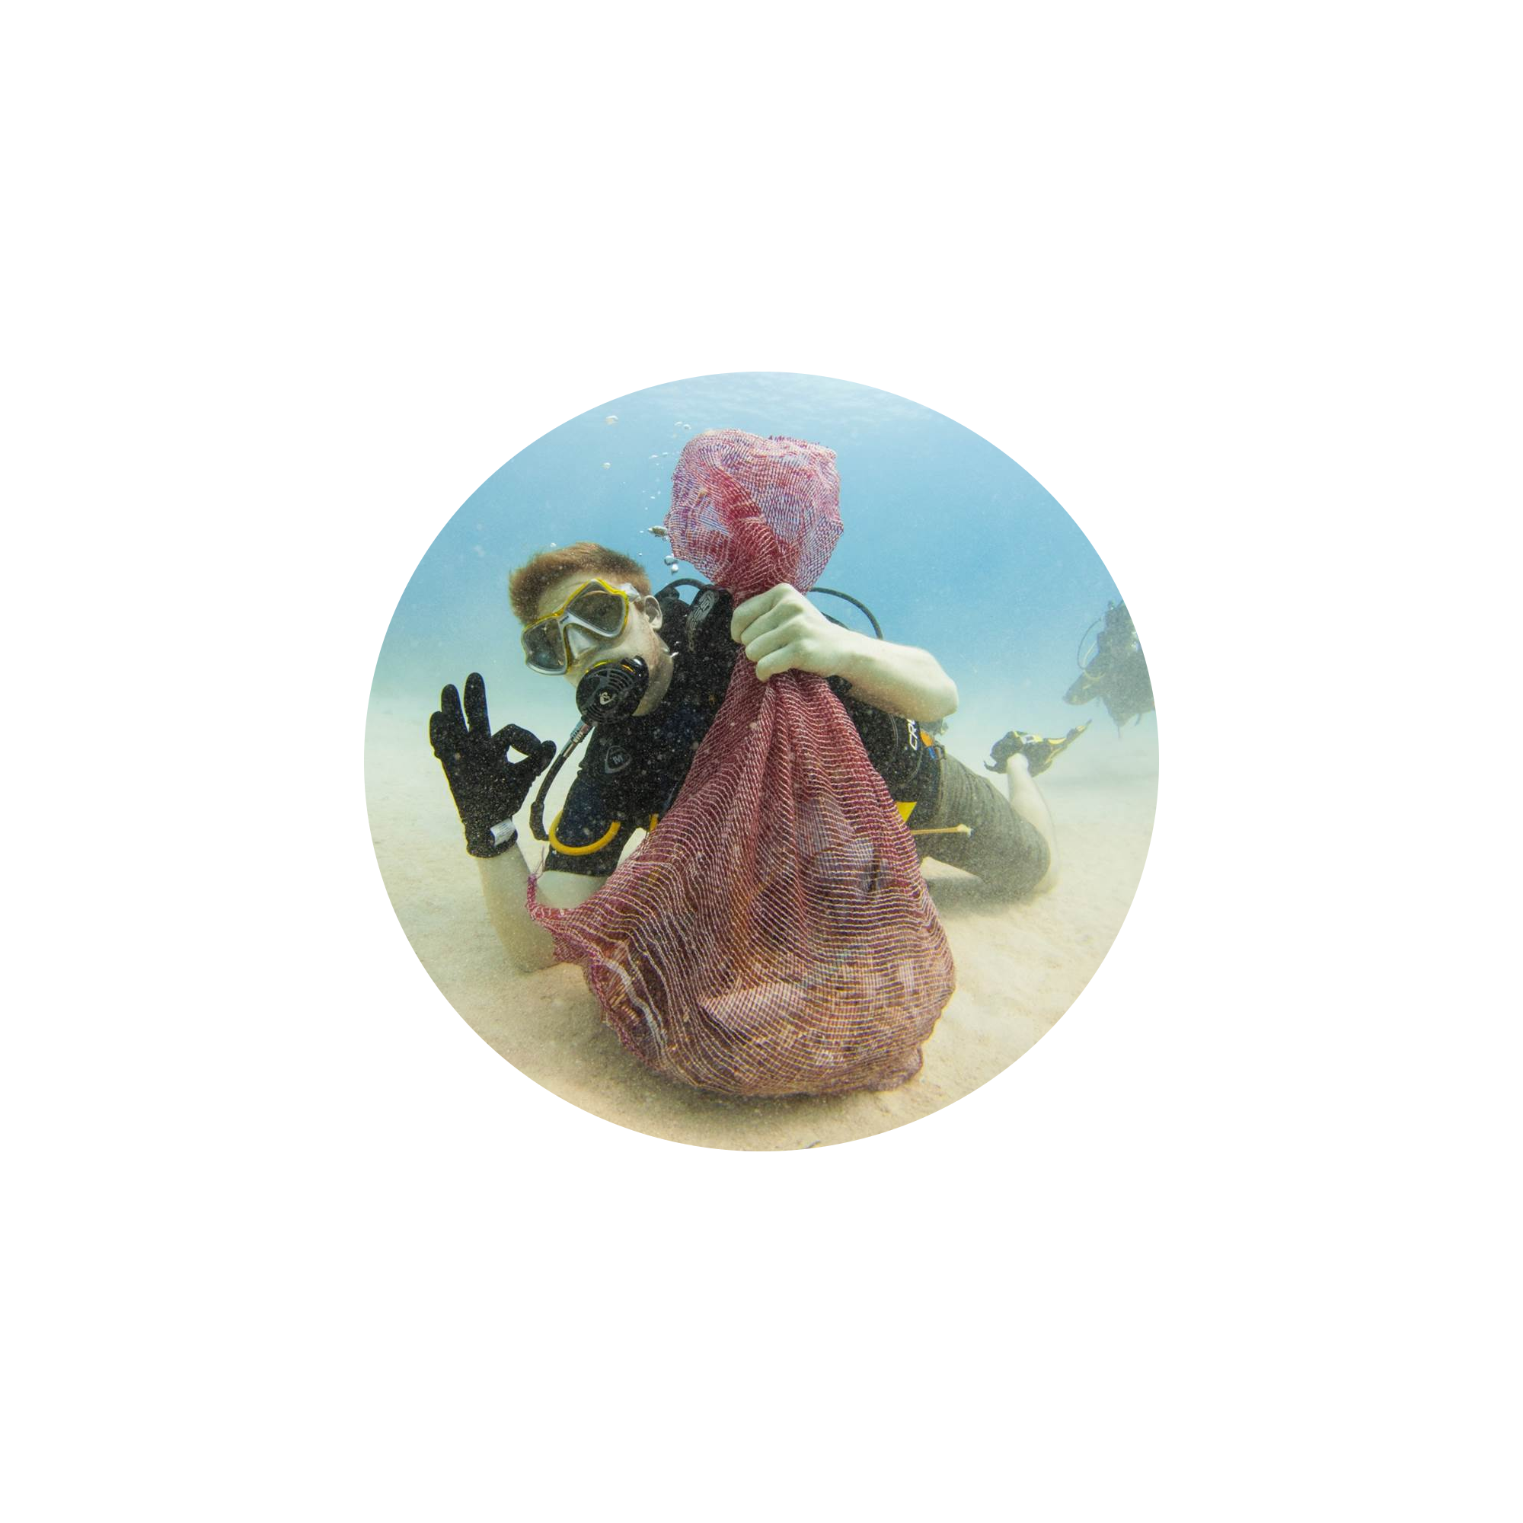
Society awareness
Recycling
New environmental law
Promoting eco-lifestyle
Notes:
Cover page
Change background image by right-clicking → Edit background Picture fill → From file

Slide 11
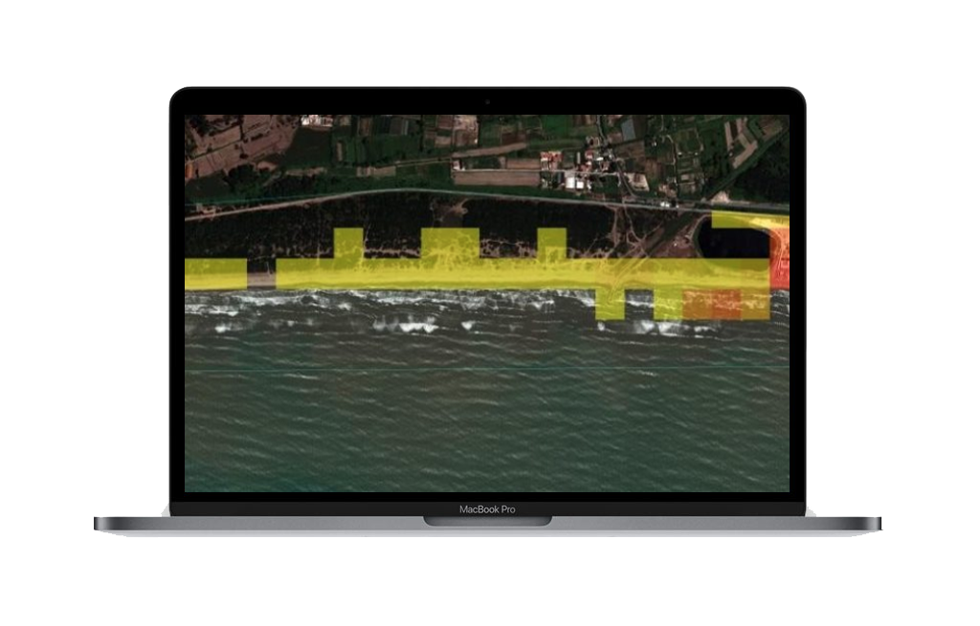
Solution
from the sky
Our solution uses thermal, optical, radar data and in the future from hyperspectral satellite
Notes:
Cover page
Change background image by right-clicking → Edit background Picture fill → From file

Slide 12
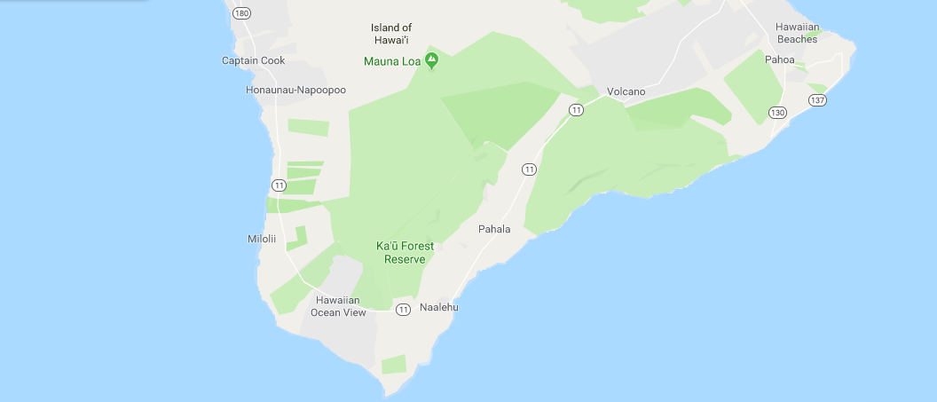
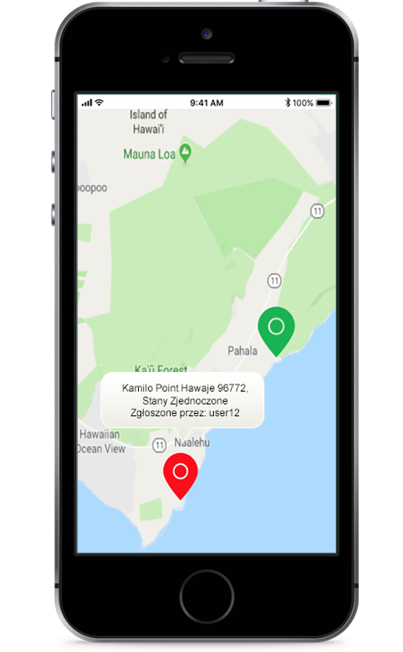
Our solution uses thermal, optical, radar data and in the future from hyperspectral satellite
Solution
from the sky
Notes:
Cover page
Change background image by right-clicking → Edit background Picture fill → From file

Slide 13
Cleanup challenge
Notes:
Cover page
Change background image by right-clicking → Edit background Picture fill → From file

Slide 14
Costs
Time
Possibility to monitor large area at once
Advantages
of our solution
Notes:
Cover page
Change background image by right-clicking → Edit background Picture fill → From file

Slide 15
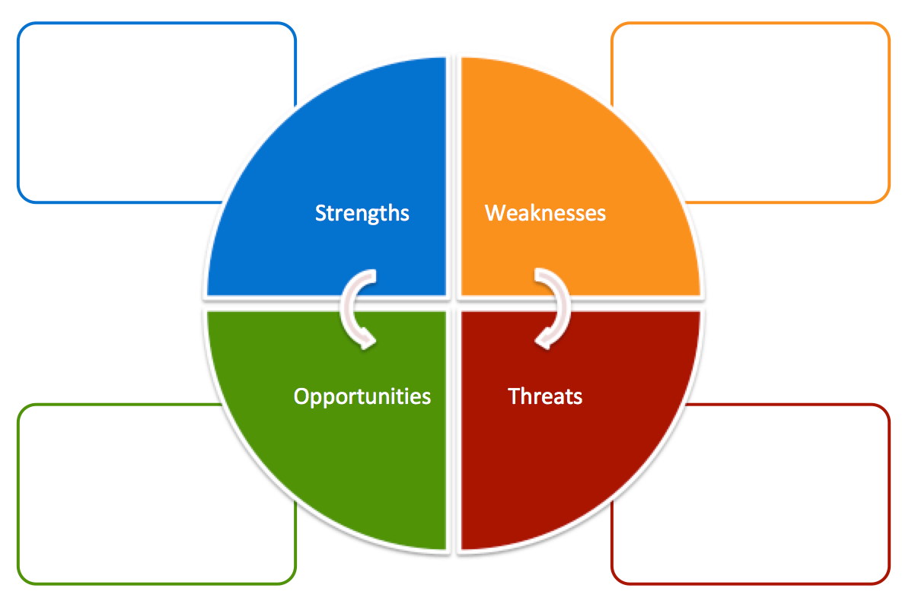
SWOT analysis
- Multidisciplinary team
- Huge automation
- Other systems integration
-Marketing
-Data accuracy
- Global problem
- Data from satellites
- International
involvement
-Weak society commitment
-Global competition
Notes:
Change background image by right-clicking → Edit background Picture fill → From file

Slide 16
Financial plan
P
M
C
Project
Development
Infrastructure
Marketing
Society education
Cooperation
Contracts
70k PLN
100k PLN
50k PLN
Notes:
Example how to present some statistics or numerical facts.

Slide 17
Thank you!
Contact
Mail: neutral.face.emoji@gmail.com
Phone: +48 692 475 660
Notes:
Space for additional information, for example contact information.
The circle illustrates the various application areas of Copernicus data.
Change background image or colour by right-clicking → Edit background Picture fill → From file

