Slide 1
The importance of bees
Sebastian Kubica
Tomasz Kosacki
Daniel Kraus
Damian Kita
Zofia Łyko
Notes:
Cover page
Change background image by right-clicking → Edit background Picture fill → From file First move the gradient mask by activating it (clicking it) and moving it from right to left (from the middle handle point on the right) This way it is easy to put the gradient back by dragging the same handle to right.

Slide 2
Boosting your business with open satellite data
Crop analysis for better produce
Notes:
Cover page
Change background image by right-clicking → Edit background Picture fill → From file

Slide 3
Solution
from
the sky
balanced and ecological agriculture
better produce
the wellbeing of bees
Notes:
Cover page
Change background image by right-clicking → Edit background Picture fill → From file

Slide 4
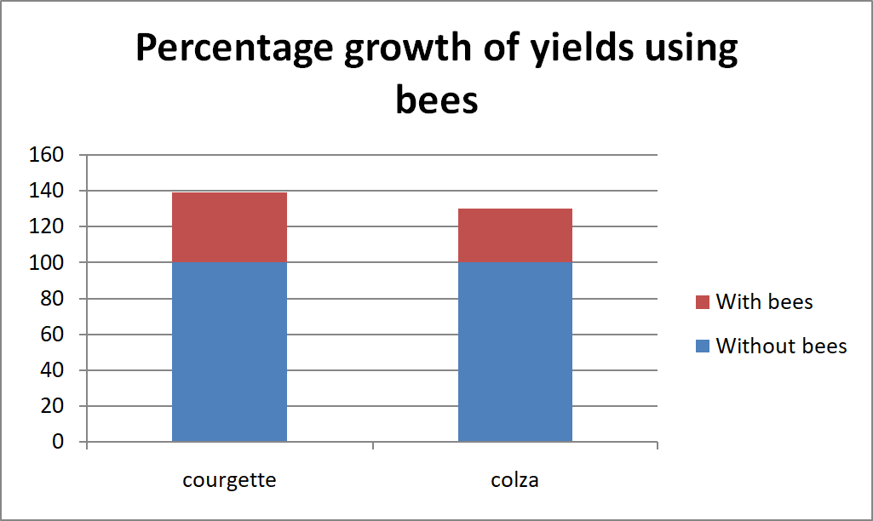
Notes:
Text slide

Slide 5
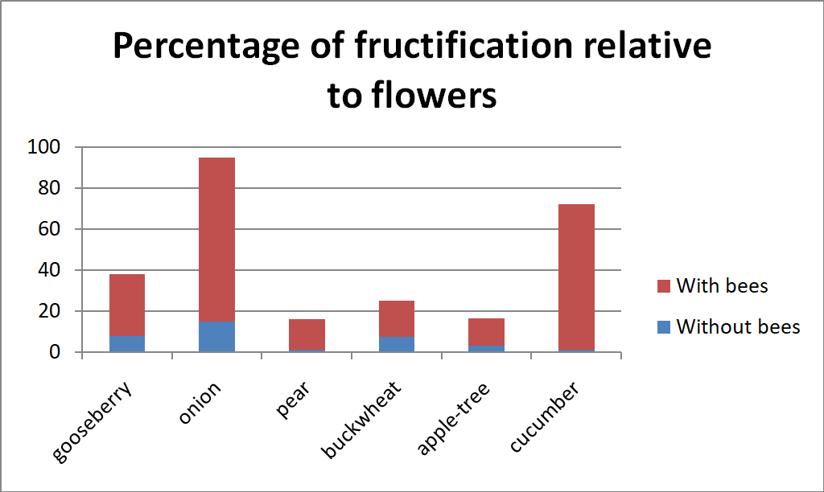
Notes:
Text slide

Slide 6
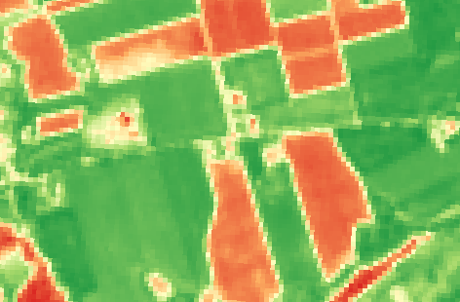
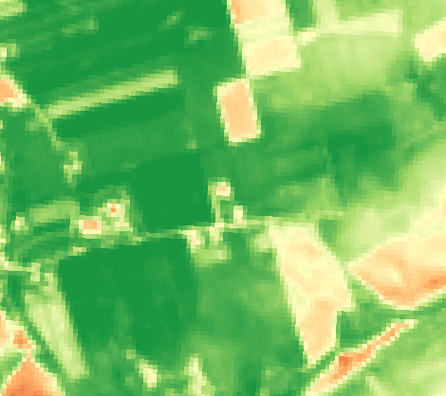
Analysis based on satellite data
May 2016 May 2018
Notes:
Text slide

Slide 7
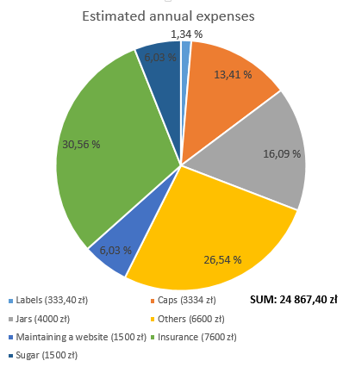
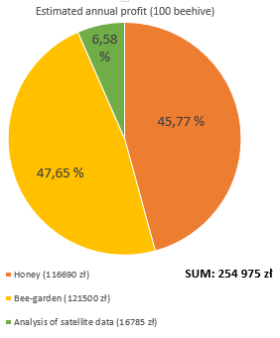
Estimated annual expenses and profits
Budget for start: 250.000 zł
Notes:
New dia -> Text + graphics 2 columns

Slide 8
Thank you!
Contact details:
E-mail: kubica96.sk@gmail.com
Phone: 534 944 336
Notes:
Space for additional information, for example contact information.
The circle illustrates the various application areas of Copernicus data.
Change background image or colour by right-clicking → Edit background Picture fill → From file

