Slide 1
Soilex
TeledetekcjoPoleX
Notes:
Cover page
Change background image by right-clicking → Edit background Picture fill → From file First move the gradient mask by activating it (clicking it) and moving it from right to left (from the middle handle point on the right) This way it is easy to put the gradient back by dragging the same handle to right.

Slide 2
We’ll help you get the soil you and your family deserve
Notes:
Cover page
Change background image by right-clicking → Edit background Picture fill → From file

Slide 3
Our goal is to
determine the quality of soil and provide you information
Notes:
Cover page
Change background image by right-clicking → Edit background Picture fill → From file

Slide 4
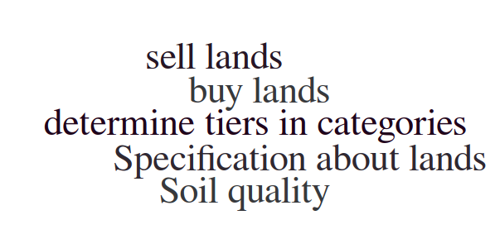
We provide following informations
Notes:
We are providing specific information about soil quality. You can choose which soil type you are looking for.
We’ll give you specific specification about działki that you are looking for.
Our revolutionary neural networks will designate TIER for different categories and will help you use your land in best possible way.
If you want to buy land you can find exactly the one you are looking for.(i teraz opisać kategorie)

Slide 5
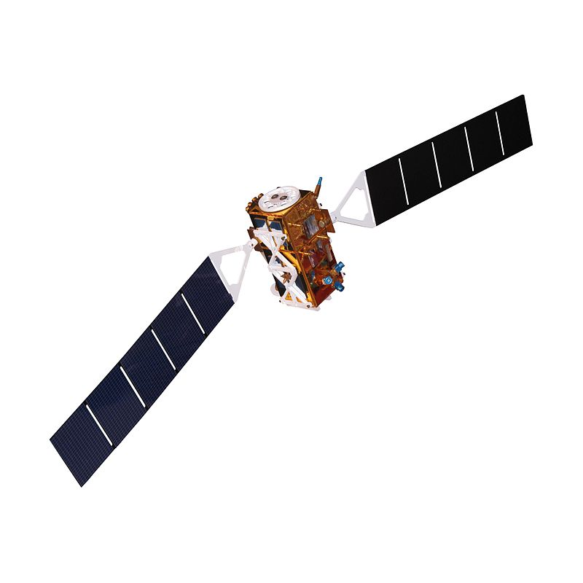
Our data
Sentinel 1
Sentinel 2
Sentinel 3
Notes:
Zanieczyszczenie, katastrofy naturalne, glownie powodzie, susze, hisotria upraw, osuwiska
1 -mapping for forest, water and soil management
2 -observation data for the next generation of operational products, such as land-cover maps, land-change detection maps and geophysical variables.
3-Providing information about the land surface that allows monitoring of parameters such as regional and continental-scale land cover, vegetation state, vegetation productivity and fire

Slide 6
How do we process data?
Neural Networks

Slide 7
Our target
Developer
People who want to buy or sell land
Individuals associated with agriculture

Slide 8
Business model

Slide 9
Profits
Our income will be based on one-off payments.
The price of measurement will depend
on complexity of required data.
Notes:
Change background image by right-clicking → Edit background Picture fill → From file

Slide 10
Thank you!
Our contact:
contact@teledetekcjopolex.pl
Notes:
Space for additional information, for example contact information.
The circle illustrates the various application areas of Copernicus data.
Change background image or colour by right-clicking → Edit background Picture fill → From file

