Slide 1
Sunny House
All you need is sun
Notes:
Cover page
Change background image by right-clicking → Edit background Picture fill → From file First move the gradient mask by activating it (clicking it) and moving it from right to left (from the middle handle point on the right) This way it is easy to put the gradient back by dragging the same handle to right.

Slide 2
Julia Humięcka
Szymon Hajnos
Arkadiusz Jeż
PRQ Team
Dominika Guzik
Justyna Jamborska
Notes:
Cover page
Change background image by right-clicking → Edit background Picture fill → From file

Slide 3
What is Sunny House?
Our application allows you to find out, if it would be efficient to install solar panels, on a particular house, field, parking lot etc.
Notes:
Change background image or colour by right-clicking → Edit background Picture fill → From file

Slide 4
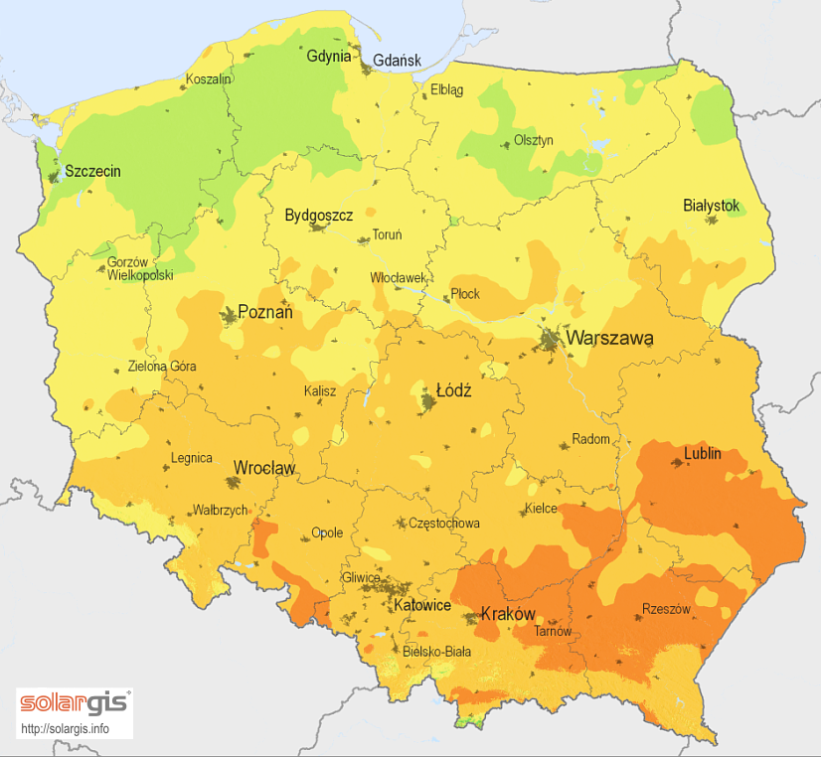
Solution
Data we will use:
Sunshine duration
Air pollution
Elevation
Solar radiation
Notes:
Change background image or colour by right-clicking → Edit background Picture fill → From file

Slide 5
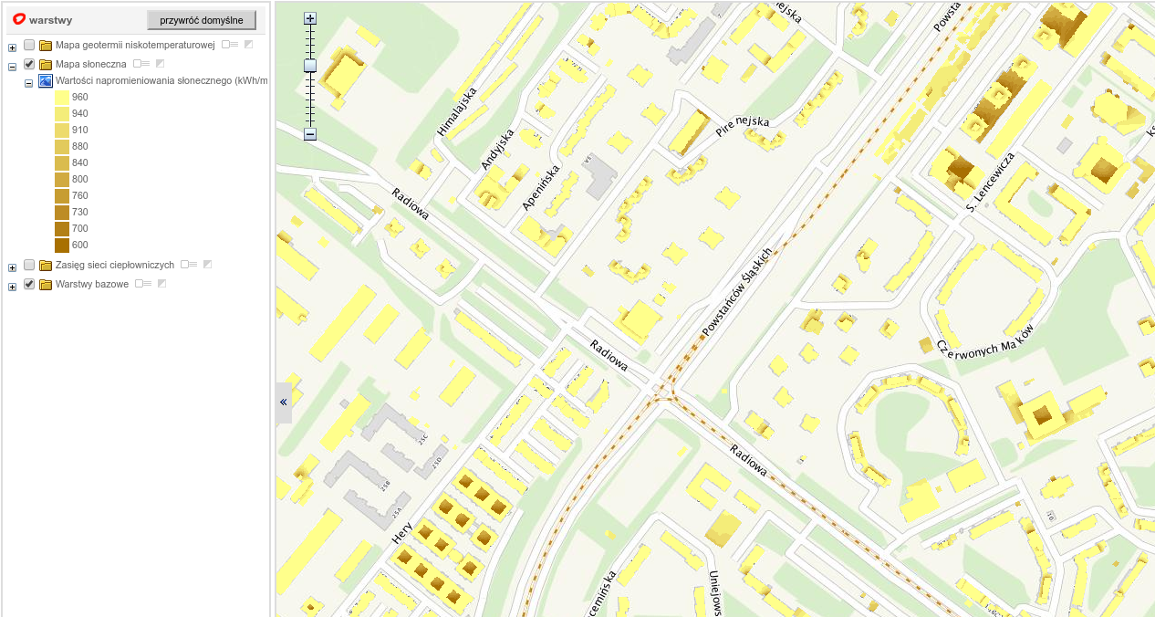
Notes:
Change background image by right-clicking → Edit background Picture fill → From file

Slide 6
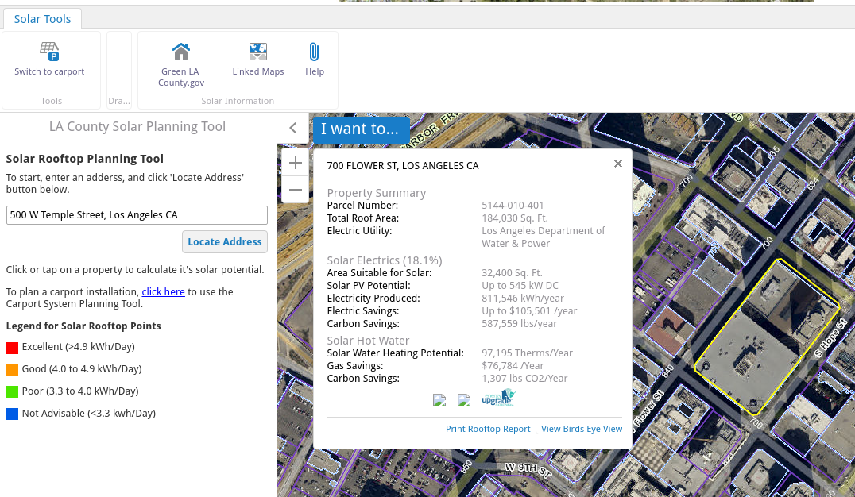
Notes:
Change background image by right-clicking → Edit background Picture fill → From file

Slide 7
How it works
Notes:
Text slide

Slide 8
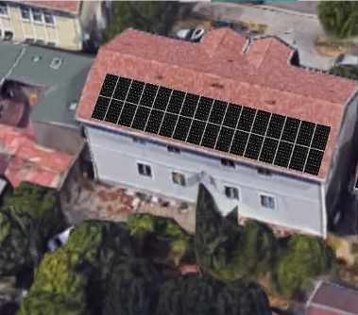
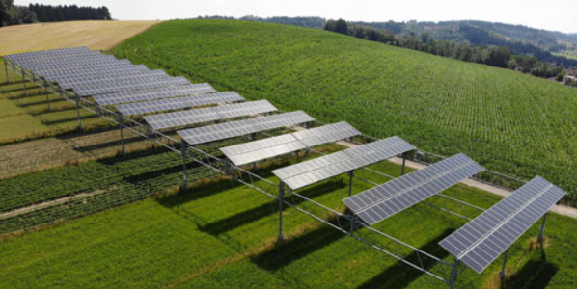
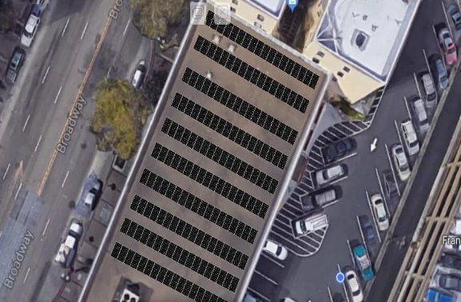
Target
companies interested in selling PV panels
individual customers interested in investing in renewable energy sources
people who want to save money on electrical energy
Notes:
Change background image or colour by right-clicking → Edit background Picture fill → From file

Slide 9
Business Plan
What we need: 150 000 zł.
What we’ll generate: 100 000 zł per year after first 2 years.
Access to the service will be subscription based.
Notes:
Change background image or colour by right-clicking → Edit background Picture fill → From file

Slide 10
How much will it cost?
Access to the service will be subscription based.
Free tier for limited use.
Professional and Enterprise tier with extended functionalities.
Notes:
Change background image or colour by right-clicking → Edit background Picture fill → From file

Slide 11
Contact info
email: nameexom@gmail.com
tel: +48 790 765 736
Arkadiusz Jeż
Notes:
Notes

Slide 12
Thank you!
Kiitos!
Notes:
Space for additional information, for example contact information.
The circle illustrates the various application areas of Copernicus data.
Change background image or colour by right-clicking → Edit background Picture fill → From file

