Slide 1
yourGROUNDS
Make grounds better again
Notes:
Cover page
Change background image by right-clicking → Edit background Picture fill → From file First move the gradient mask by activating it (clicking it) and moving it from right to left (from the middle handle point on the right) This way it is easy to put the gradient back by dragging the same handle to right.

Slide 2
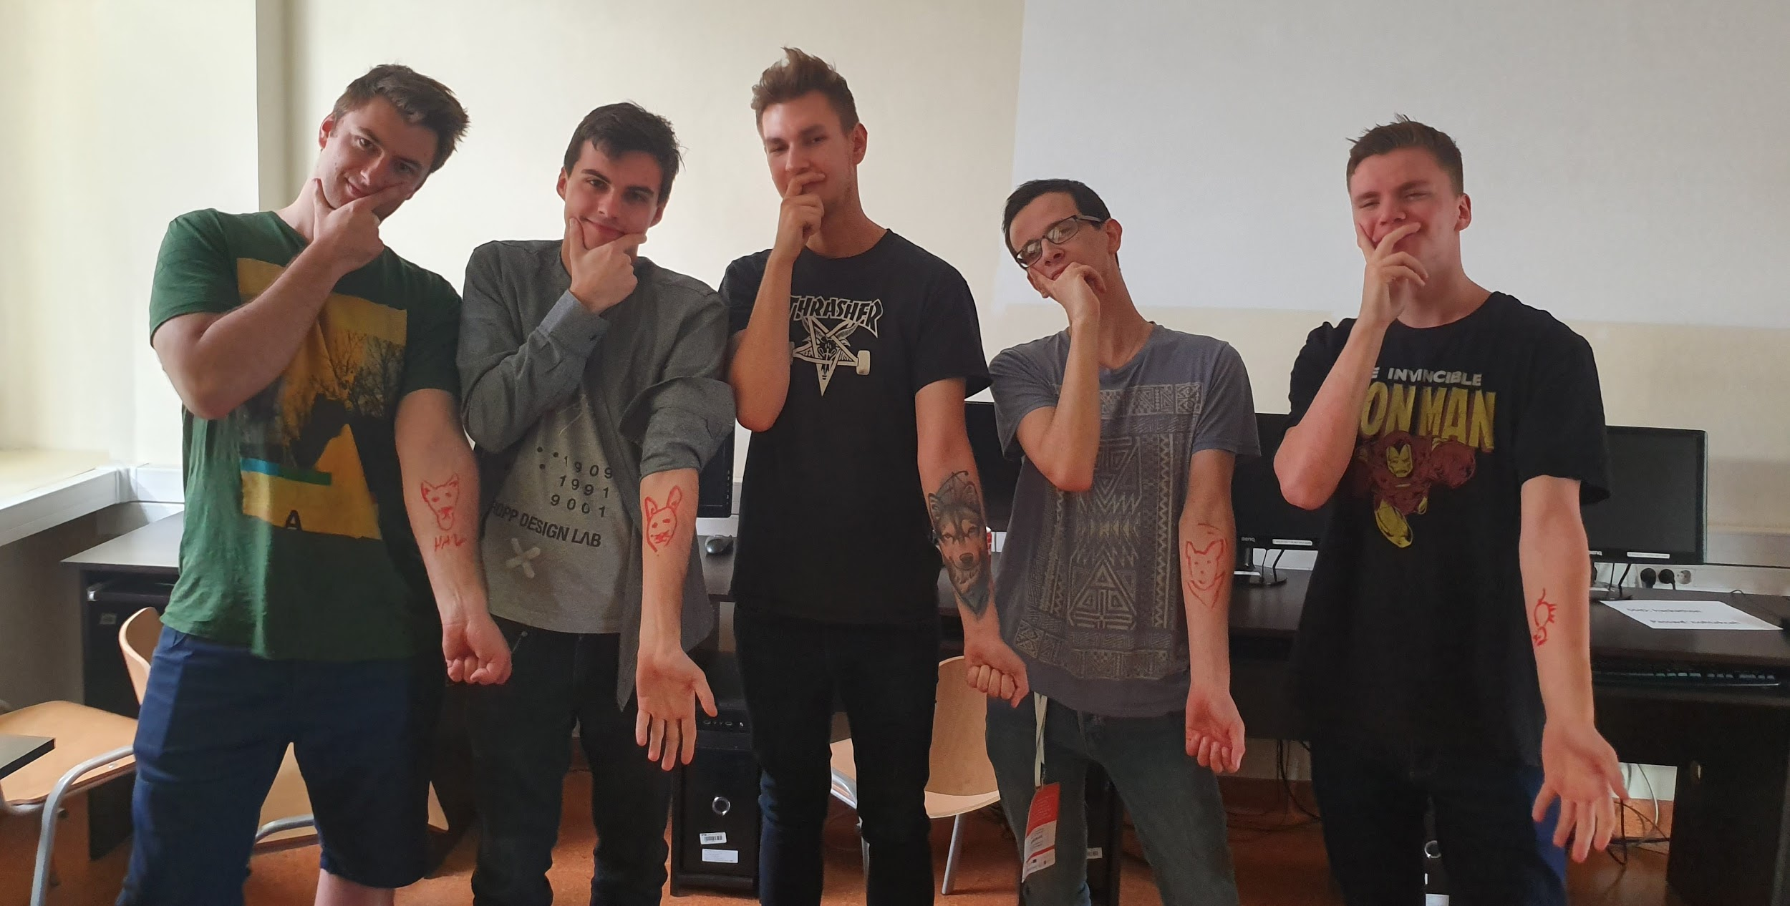
Our team
3rd year students
Cracow University of Science
Notes:
Cover page
Change background image by right-clicking → Edit background Picture fill → From file

Slide 3
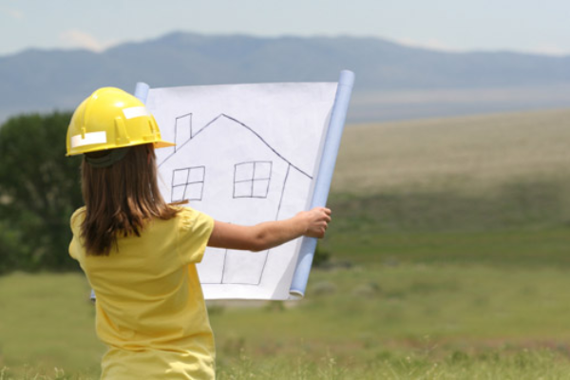
Do you know what problems might affect your dreamt building plot?
Notes:
Cover page
Change background image by right-clicking → Edit background Picture fill → From file

Slide 4
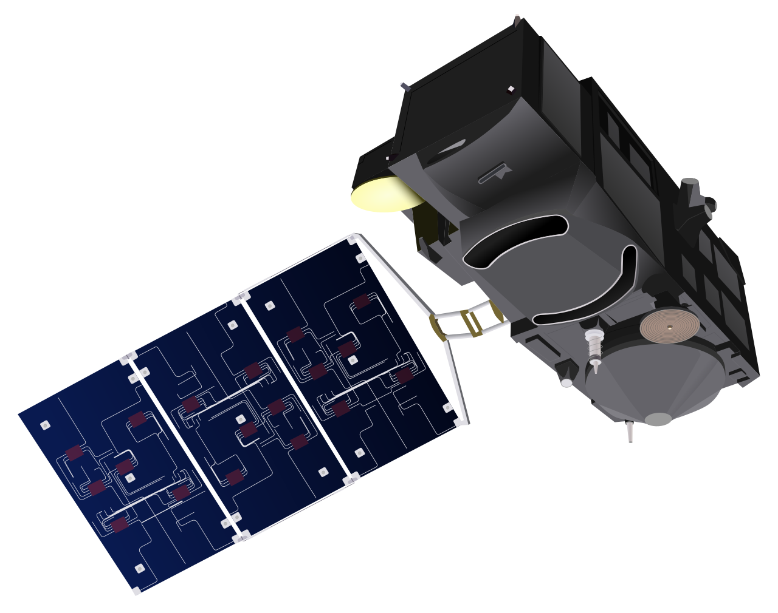
Solutions
Notes:
Change background image by right-clicking → Edit background Picture fill → From file

Slide 5
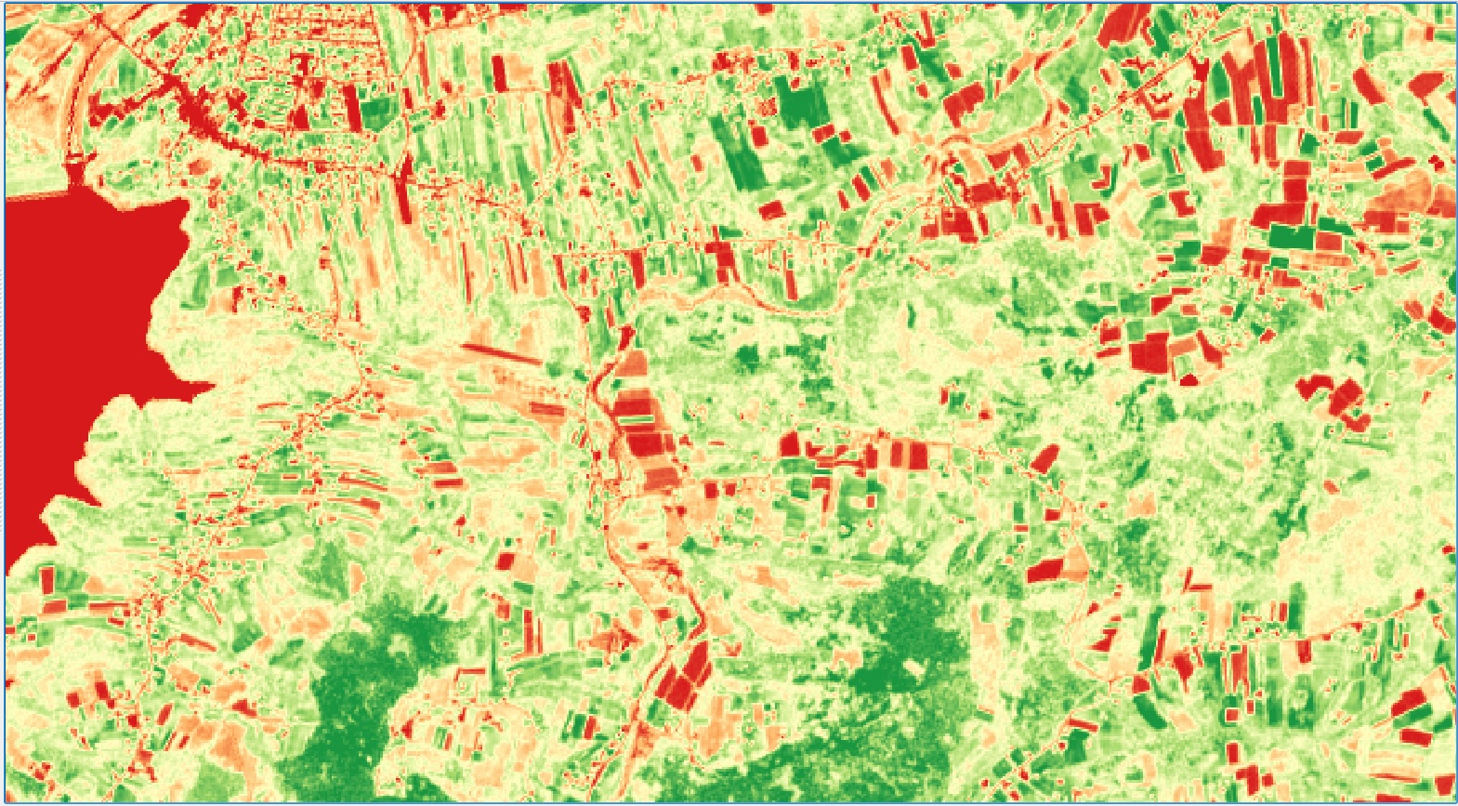
Our product
Notes:
Example how to emphasize some facts.

Slide 6
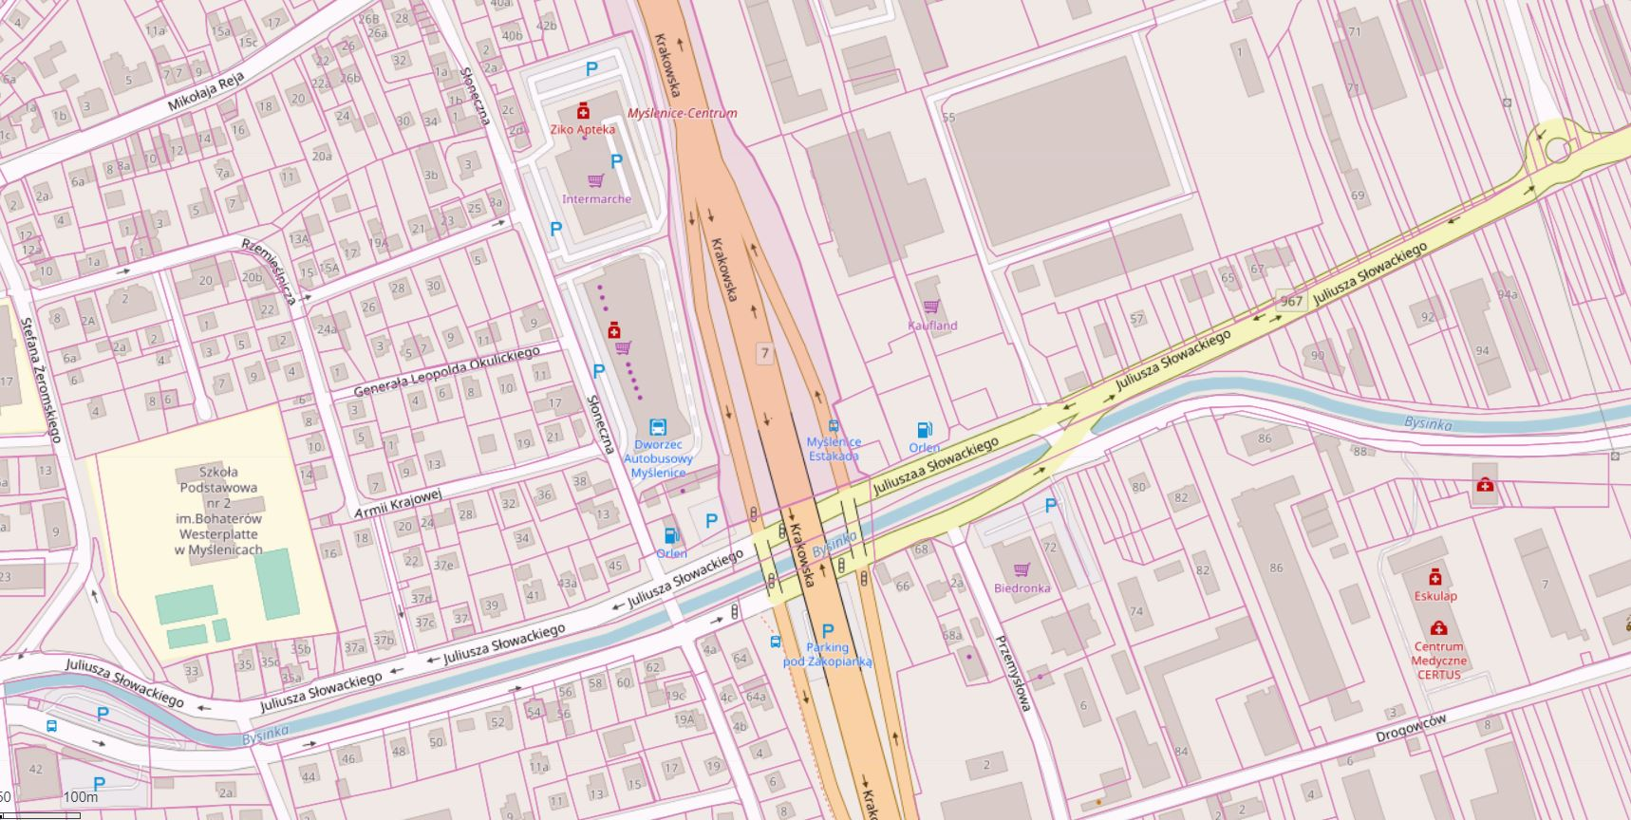
Notes:
Change background image by right-clicking → Edit background Picture fill → From file

Slide 7
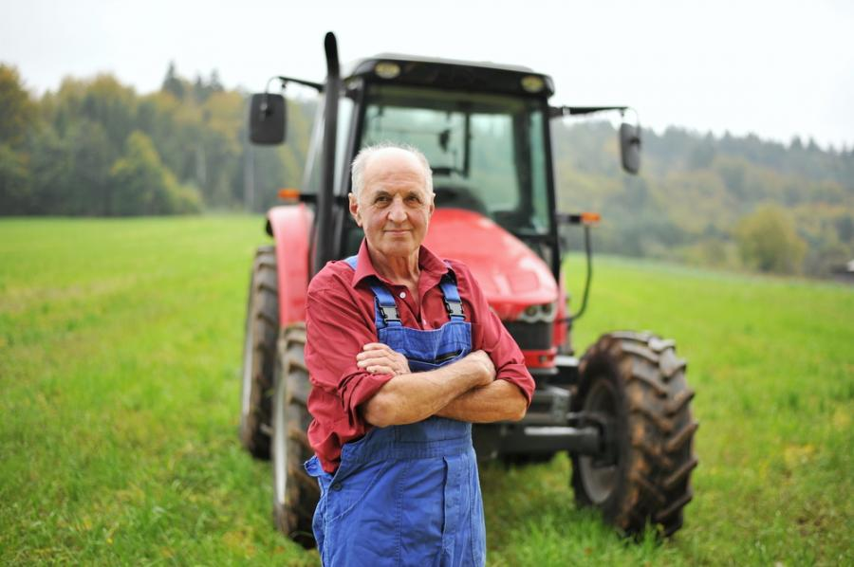
Market
Notes:
Change background image by right-clicking → Edit background Picture fill → From file

Slide 8
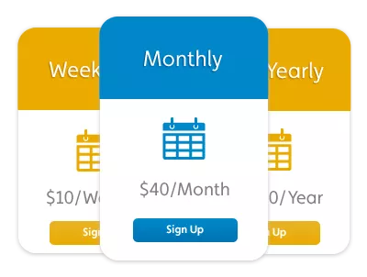
Business model
Notes:
Text slide

Slide 9
INVESTING
Notes:
Change background image by right-clicking → Edit background Picture fill → From file

Slide 10
CONTACT US!!!
Playerunymngraunds
Cracow
yourgrounds@protonmail.com
Notes:
New dia -> Text + graphics 2 columns

Slide 11
Thank you!
:)
Notes:
Space for additional information, for example contact information.
The circle illustrates the various application areas of Copernicus data.
Change background image or colour by right-clicking → Edit background Picture fill → From file

